Slide 1
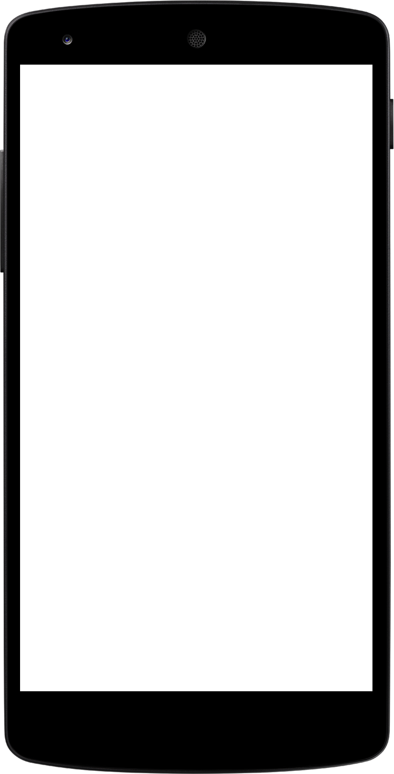
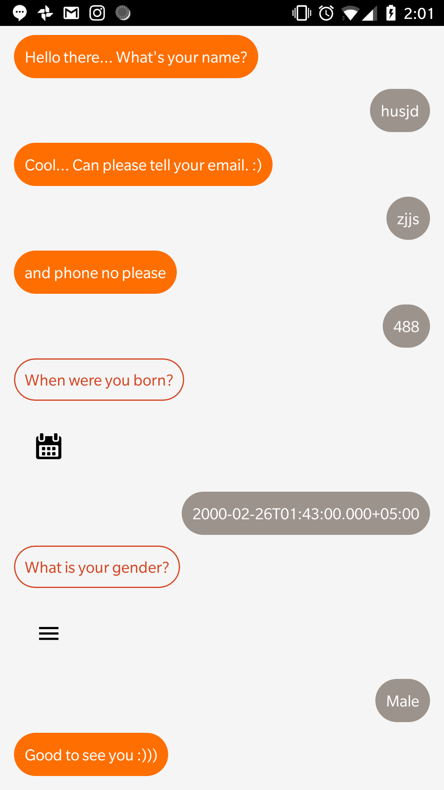

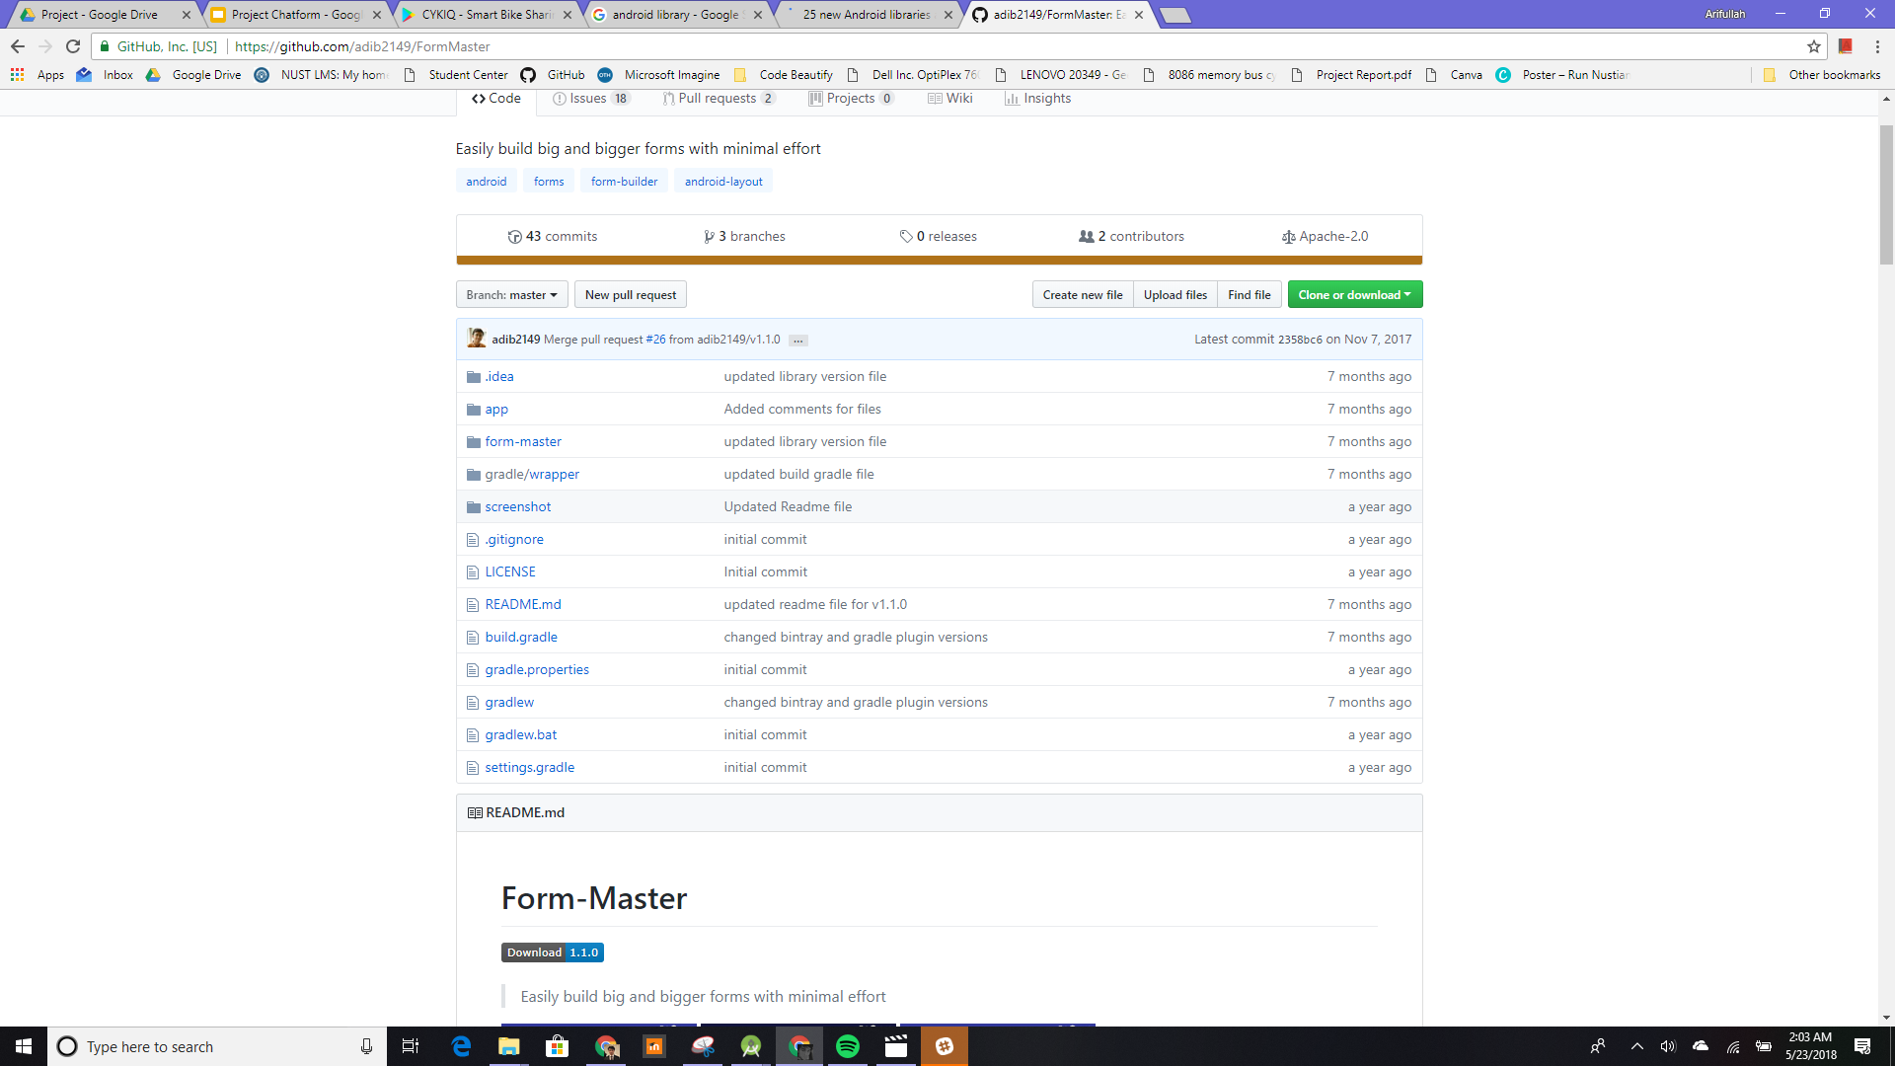
Project Chatform
An innovative design concept of interactive lengthy forms.
(It is not a chat bot)

Slide 2
Group Members
Arifullah Jan
Waqas Yaseen
Yahya Tahir

Slide 3
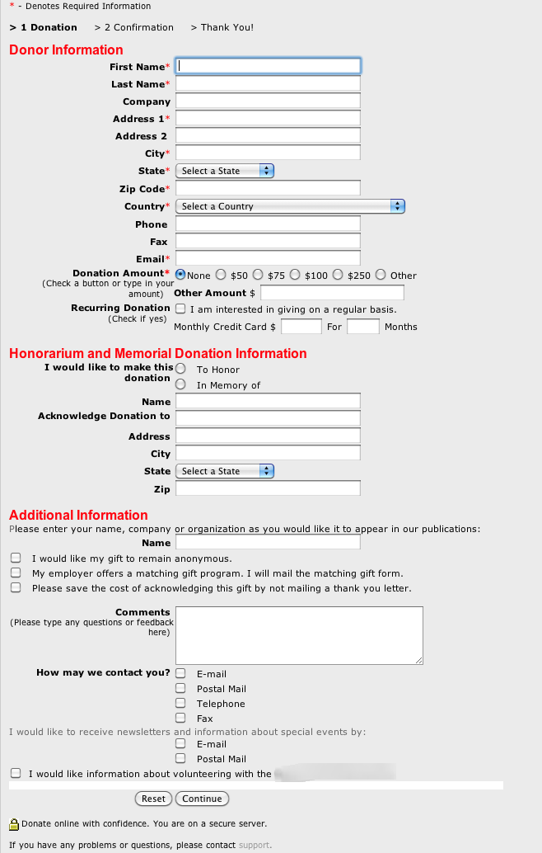
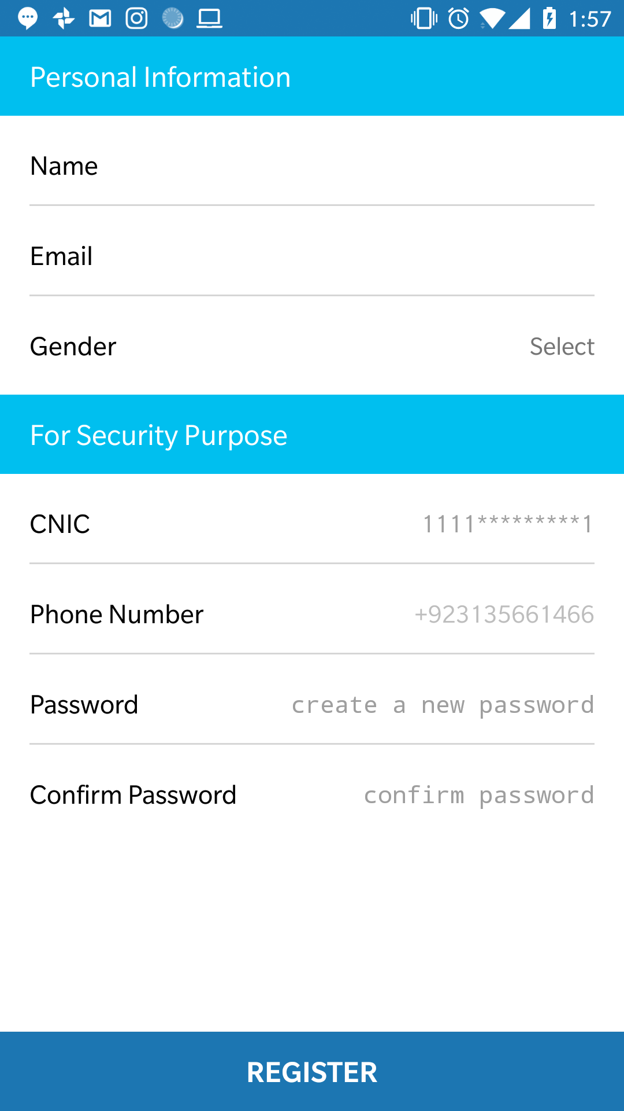
The Problem
Ever had to fill a lengthy form such as cykiq’s signup form.
Bad at first impression.
May cause not even going forward. You lose users.

Slide 4

It should is quick and easy at first impression.
01
1
The user is not shown the whole lengthy form in the first place.

Slide 5

Users like it.
02
It’s just so interesting… Users get super engaged.

Slide 6

Input type aware!
03
It has the ability to adapt to the type of the input e.g. string, email, date, etc..

Slide 7
It’s chat ui

Slide 8
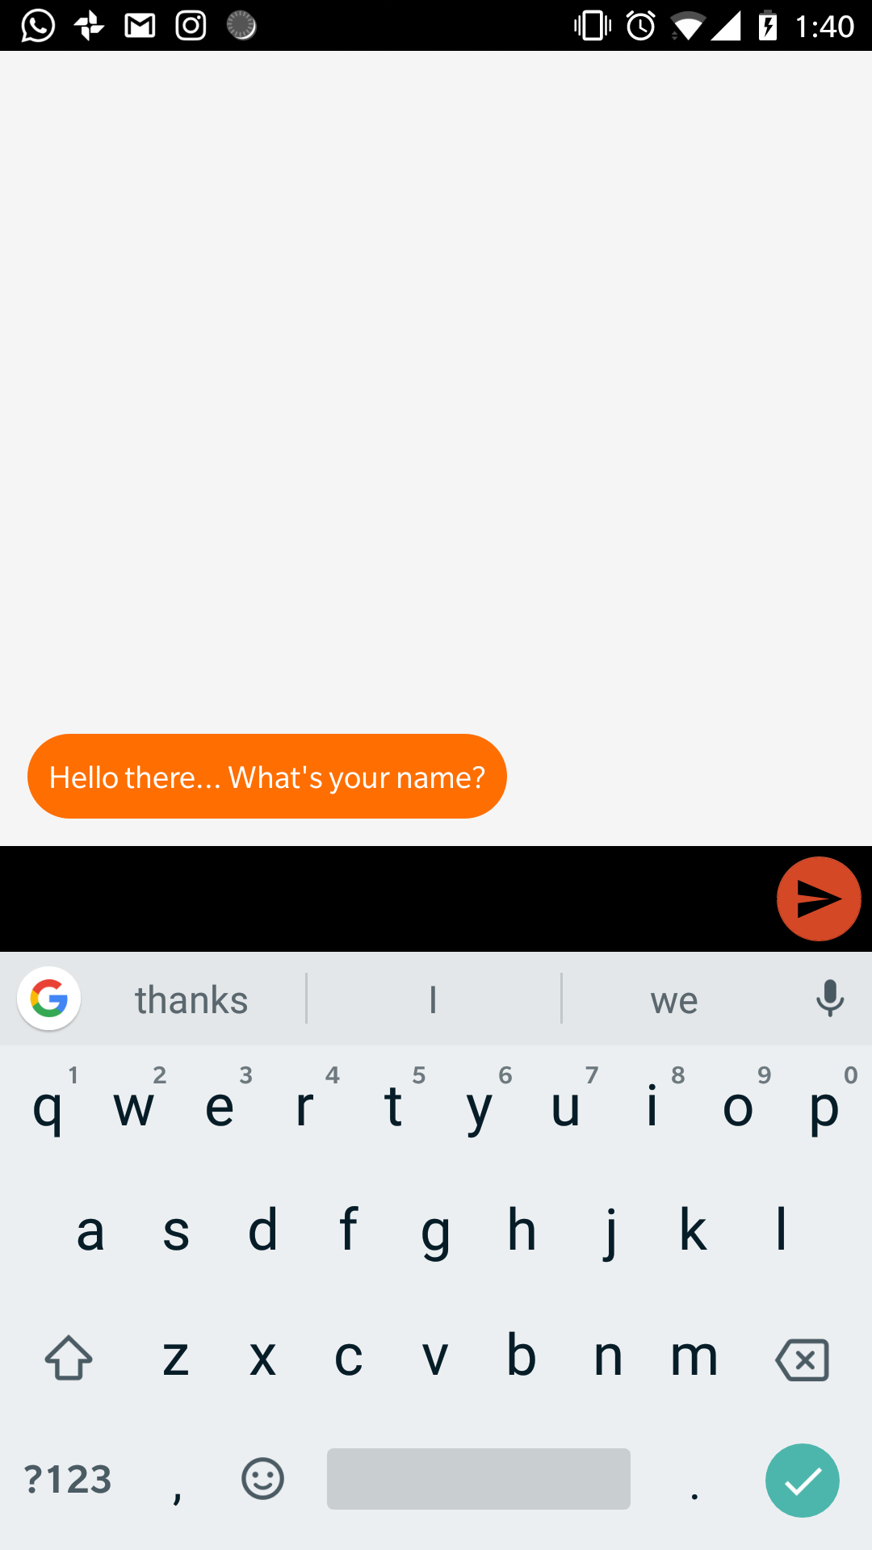
Component Detail (Mobile)
Interactive

Slide 9
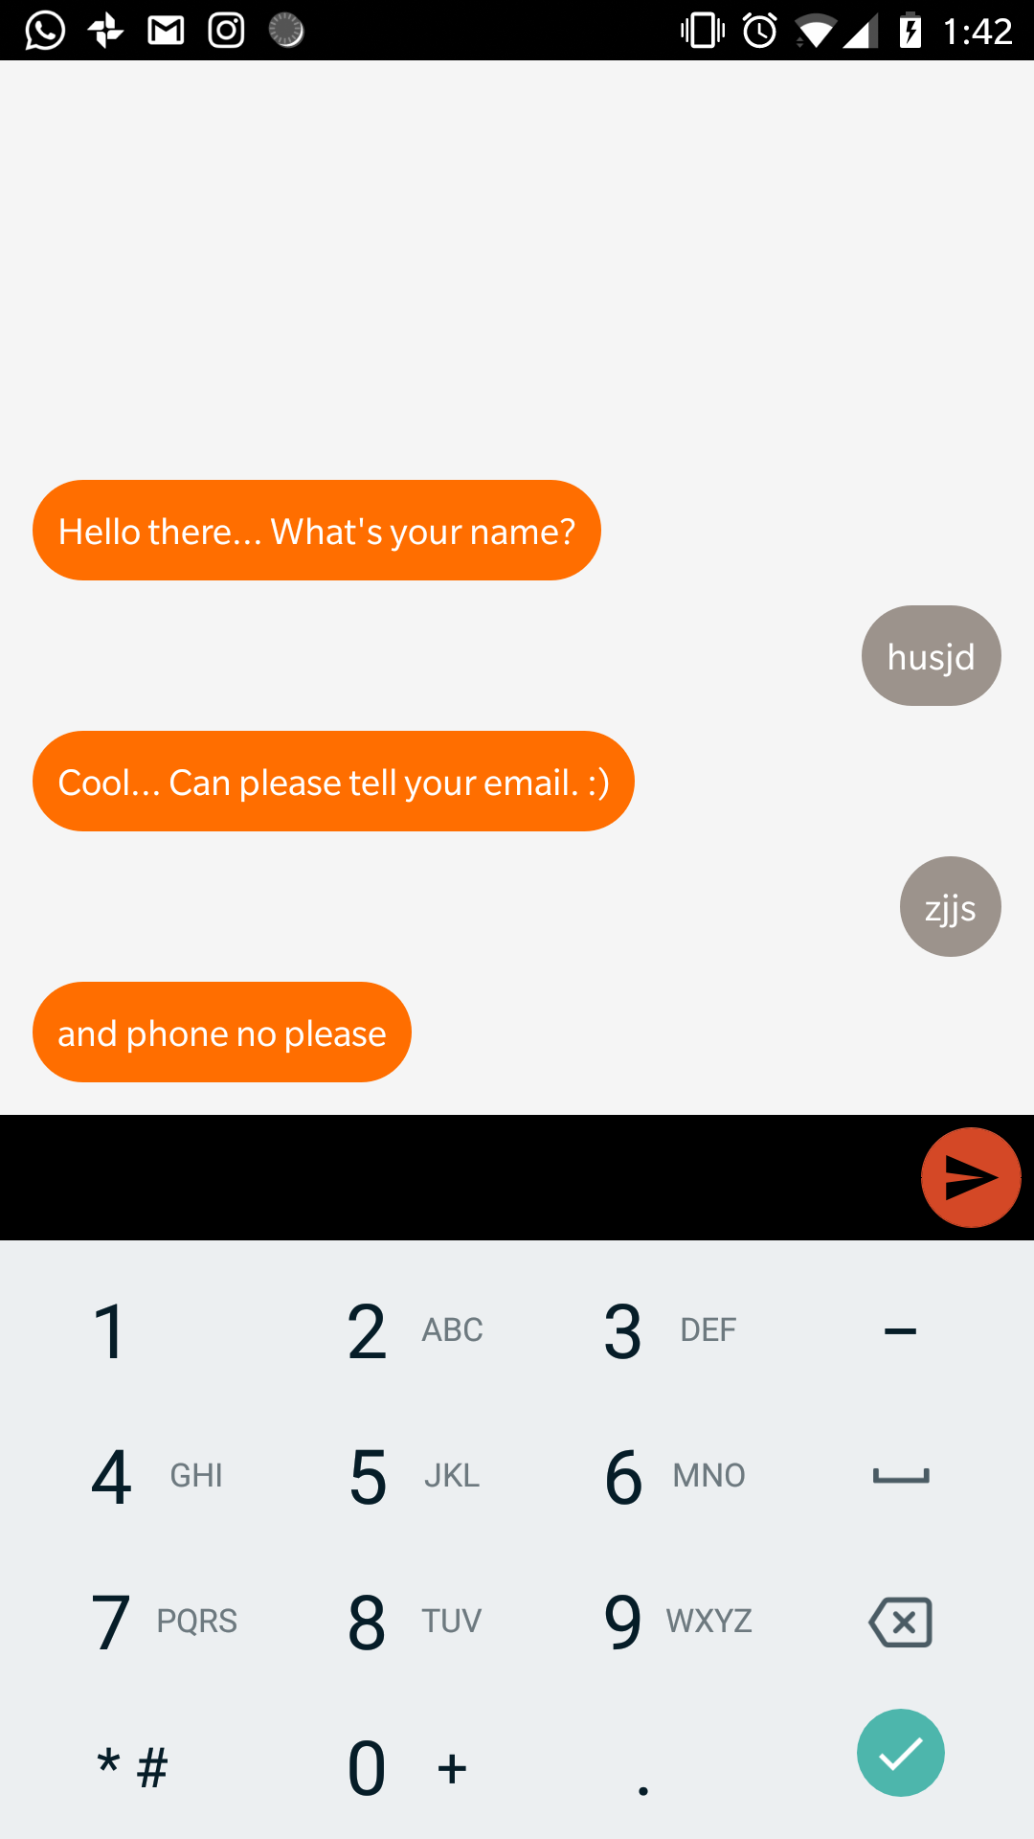
Component Detail (Mobile)
Responsive to the type of input.

Slide 10
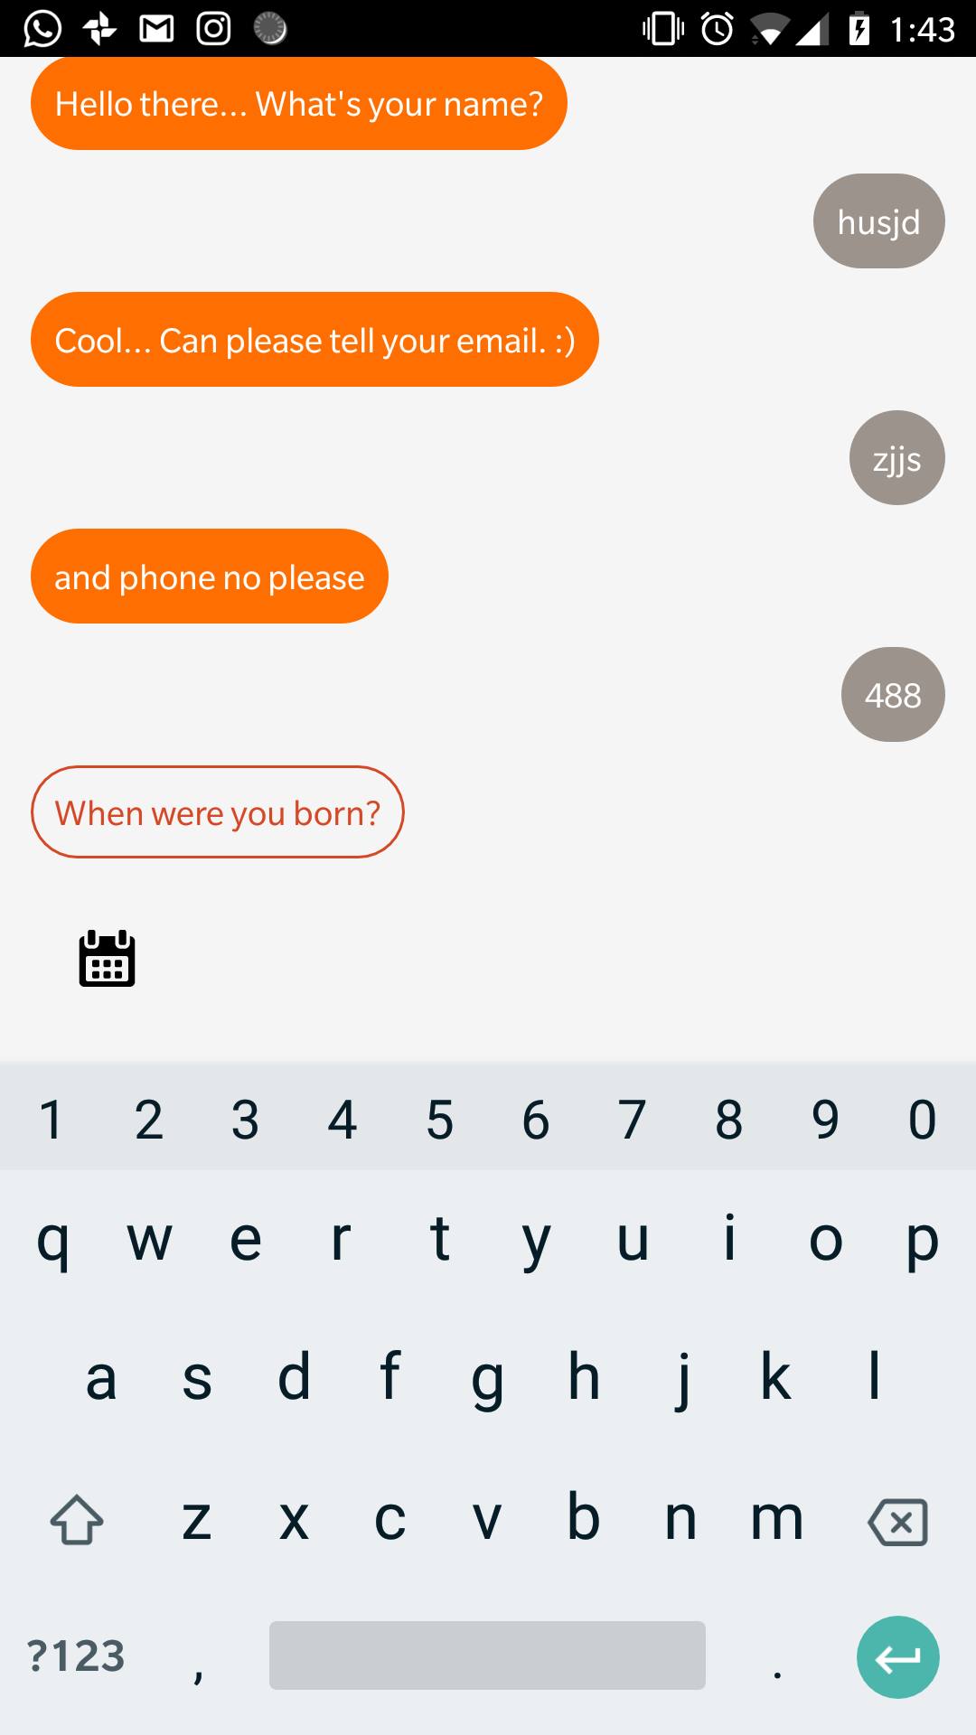
Component Detail (Mobile)
Button to open the chooser

Slide 11
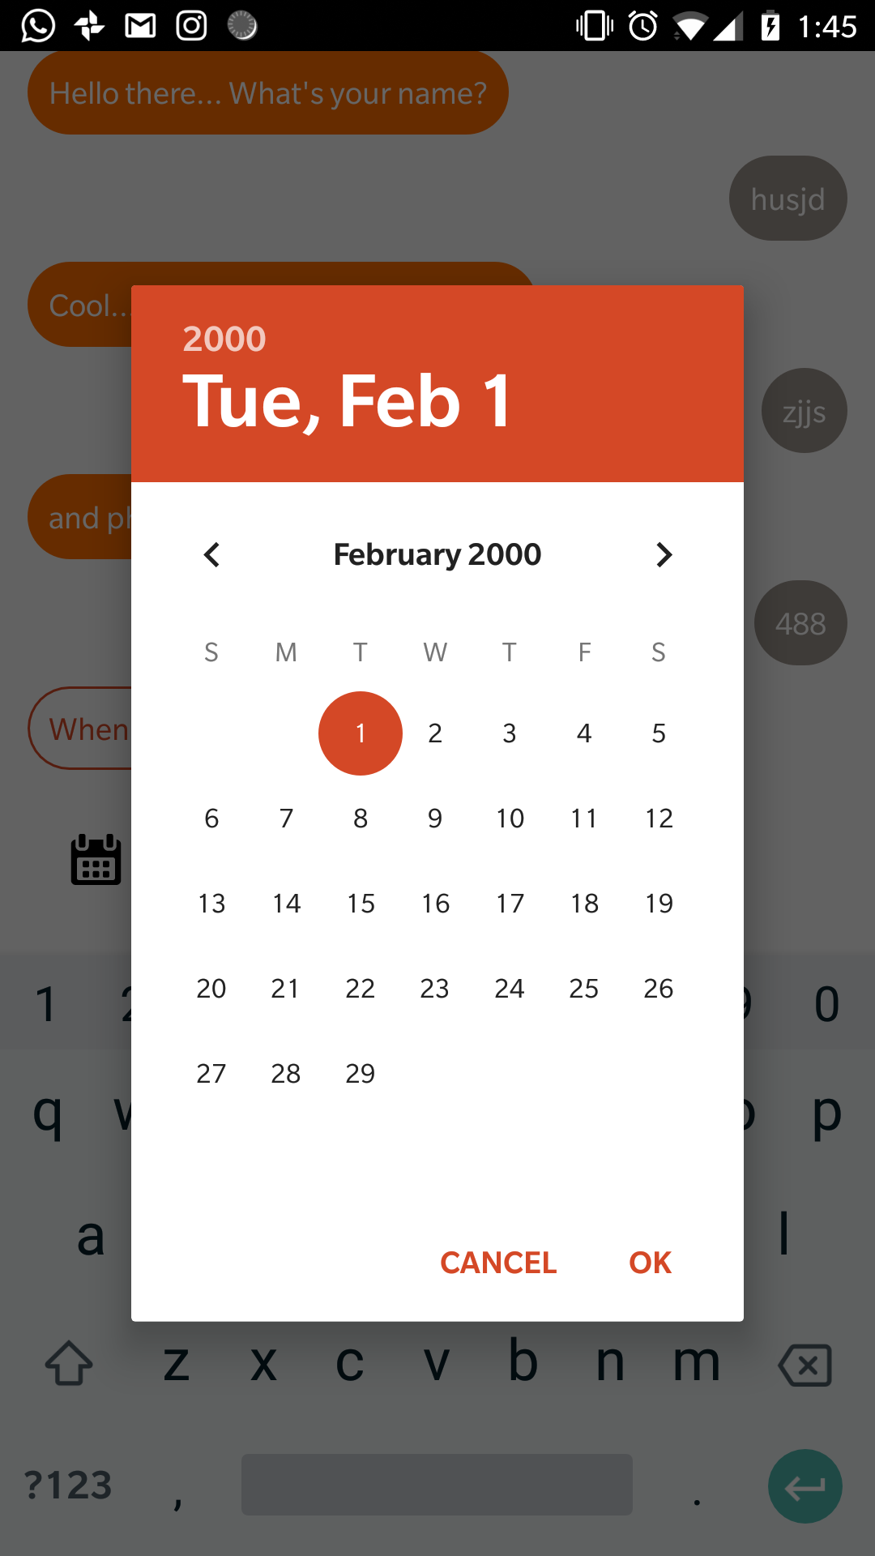
Component Detail (Mobile)
Easy to interact with chooser dialog.

Slide 12

Component Detail (Mobile)

Slide 13
Prototype type:
Vertical Prototype.
We didn’t focus on traditional HCI concepts because our project is a new concept as a whole.

Slide 14


Our Goal
Chatform Library
Open Source library so that anyone can use it in their app.
A survey making and filling app like Google forms.
ChatForm apps and webapps

Slide 15
Use cases
Signup forms.
Boring survey forms.
Program wizards.

Slide 16
Why it’s better than existing solutions
(Code design architecture wise)
FormMaster
Accepts:
List of FormElements. Each type of input has a separate class.
Need to set title, hintText, header
Still a mess.
ChatForm
Accepts:
List of Questions. Same class for all the input types.
No need to add hints texts etc.
It is clean….
https://github.com/adib2149/FormMaster
Vs ChatForm

Slide 17
Tools used
Android Studio
Reactive Programming
Databinding

Slide 18
References
No references.

Slide 19
Questions?

